Slide 1








BASICS OF MECHATRONICS
(FA5R EL3RAB)
Presented by : Team 7

Slide 2
OUR TEAM
Abdelrhman Essam
Abdelrhman Elbeeh
Ahmed Maher
Youssef Ibrahim
Yassin Ibrahim

Slide 3






PROJECT OVERVIEW
The project is a smart mechanical game that uses two types of balls:
· White balls → increase the player’s score
· Black balls → decrease the player’s score
The system begins with a feeding unit that releases balls into a shooting mechanism, which launches the ball along a defined path. The ball is then transferred through a lifting mechanism that elevates it to a higher level, allowing it to continue its motion through the system.
At the final stage, the ball reaches a decision area controlled by a movable slider (cylinder) operated by the player. The player must adjust the slider position to guide the ball into the desired path based on its color:
· Directing a white ball to the correct slot increases the score
· Directing a black ball incorrectly may reduce the score
This introduces an element of timing, control, and quick decision-making, making the game both challenging and engaging.

Slide 4


USER RESEARCH
Target Age Group: Children aged 2 to 10 years old.
Key Insights & Preferences:
Children in this range learn best through tactile feedback and cause-and-effect gameplay.
Bright colors and moving parts sustain their attention span.
Safety and durability are the top priorities for parents and supervisors.
How Insights Informed the Design: * The toy was split into two stages: a low-speed sorting mechanism for cognitive development, and an exciting shooting mechanism to reward the child and keep them engaged.

Slide 5
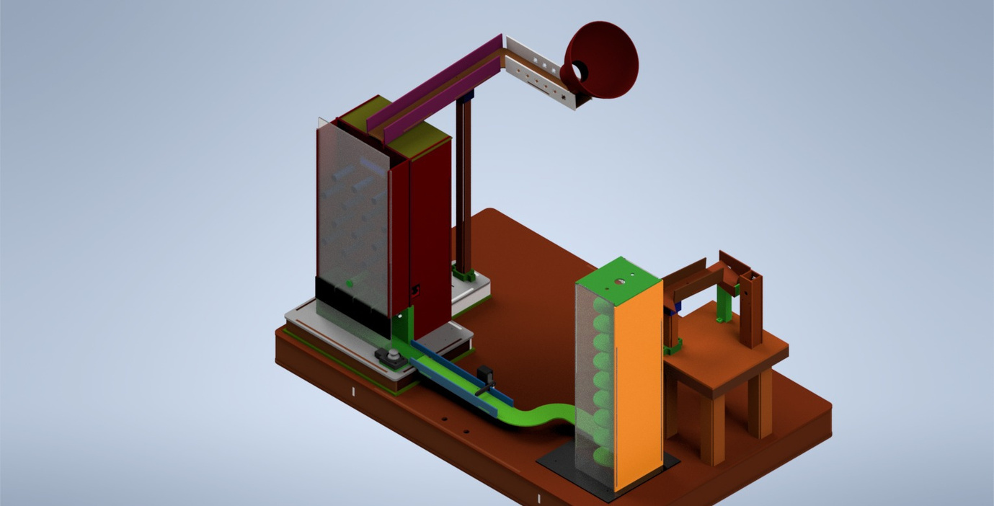
DESIGN CHALLENGE
The Core Challenge: Designing a multi-functional toy that seamlessly integrates mechanical sorting, electromechanical lifting, and safe projectile shooting within a child-friendly form factor.
Why it Matters: * Standard toys often offer static functionality (either just sorting or just moving). Combining both challenges the child's problem-solving skills.
User Benefits:
Cognitive: Enhances shape recognition and spatial awareness through the sorting puzzle.
Physical: Improves hand-eye coordination when catching or targeting the launched balls.

Slide 6

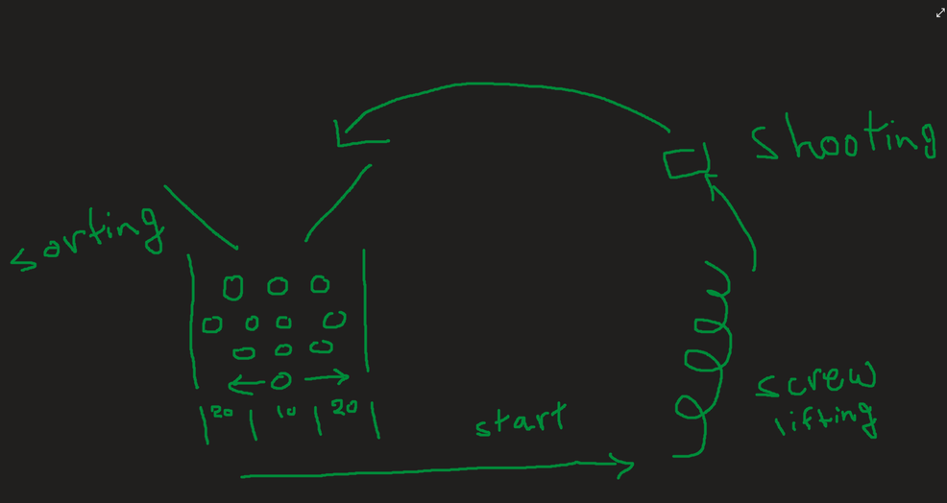
IDEATION
Sketches & Layouts: Hand-drawn sketches were made when we first think about the game
Brainstorming Phase: The team started with a broad goal: "How can we create a toy that combines engineering principles (mechanics & electronics) with early childhood education?
Concept Evolution: First Idea: A simple static shape-sorter (rejected for being too traditional and low engagement).
Second Idea: A moving car in track (rejected due to safety and high complexity for the 2-5 age group).
Final Concept: An interactive ball toy that links logical thinking with an exciting physical reward.

Slide 7
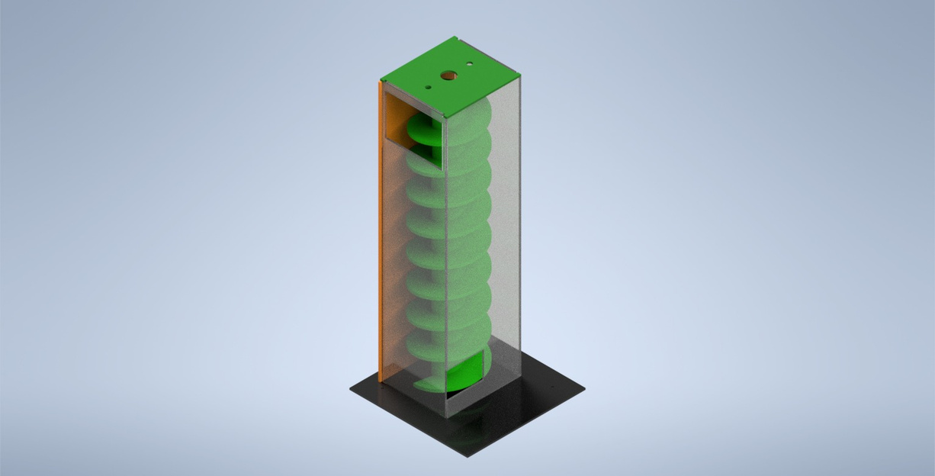
MECHANICAL ELEMENTS
Mechanism Type: Archimedes Screw
Purpose: Vertically elevating the balls from the bottom collection area up to the shooting chamber using continuous rotary motion.
Ball Capture: Once the balls enter the bottom of the shaft, they fit into the grooves of the screw.
Rotational to Linear Motion: A DC motor rotates the Archimedes screw. As the screw turns inside its housing, it transforms the rotational movement into a continuous upward linear lifting force.
Discharge: At the top, the ball rolls out of the screw directly into the shooting mechanism's launching ramp

Slide 8
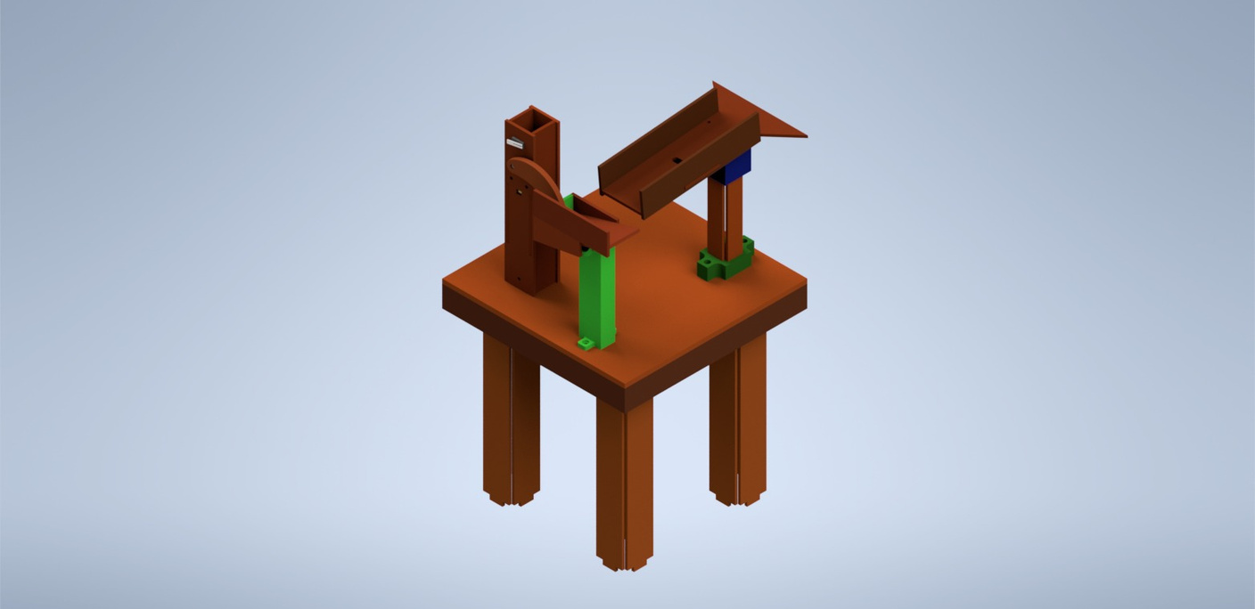
MECHANICAL ELEMENTS
Mechanism Type: DC Motor Driven Striker.
ArmPurpose: Launching the ball using projectile motion to loop it back into the sorting area, completing the gameplay cycle.
Ball Positioning: After exiting the Archimedes screw, the ball rolls down and nests perfectly into the designated launching pocket.
Actuation & Striking: A high-speed DC motor rotates a rigid striker arm.
Energy Transfer: As the arm rotates, it hits the stationary ball with an impact force, transferring kinetic energy to it instantly.
Projectile Launch: The ball leaves the curved ramp at a specific launch angle, converting the impact into a precise Projectile Motion

Slide 9
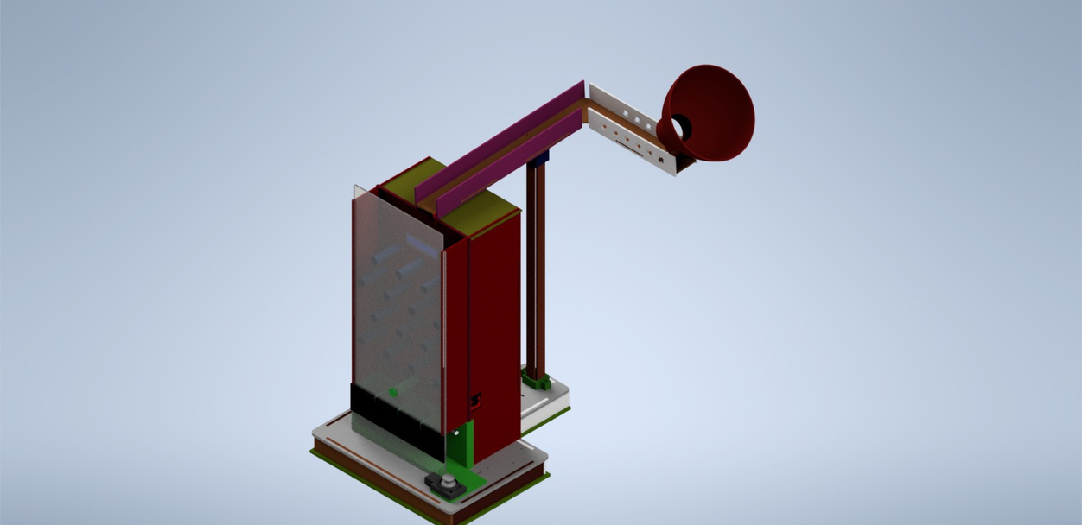
MECHANICAL ELEMENTS
Mechanism Type: Rack and Pinion with a Plinko-style Obstacle Board.
Purpose: Directing the ball into specific sorting bins through an interactive, player-controlled system.
The Random Drop (Plinko Effect): When the ball is launched from the previous stage, it drops onto a board filled with stationary pins. The ball hits these pins randomly, creating an unpredictable path.
The Child's Intervention (Joystick Control): To add excitement, the child uses a Joystick to control the game.
Rack & Pinion Actuation: The joystick signals a DC/Stepper motor equipped with a Pinion. This pinion moves a horizontal Rack.
The Sorting Funnel: Connected to this Rack is the lower moving funnel. By moving it, the child tries to catch the randomly falling ball and direct it into the correct target slot or color bin

Slide 10
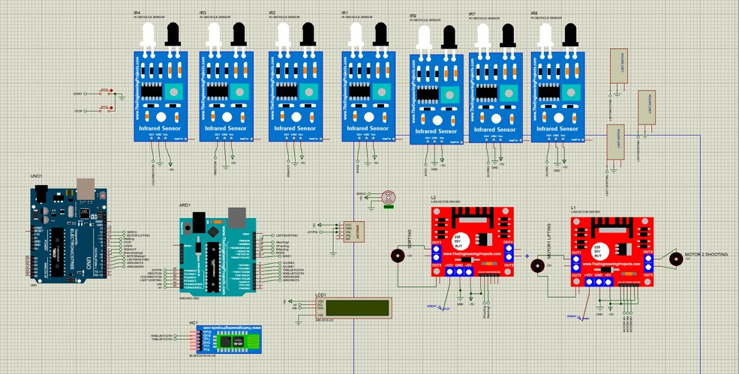
ELECTRICAL AND CONTROL ELEMENT
1 ir to detect ball for shooting and dc motor rotates arm
Dc motor rotates lifting
2 irs used to detect the color of the ball
4 irs in each slot to detect whether ball scored or miss
Joy stick used to move controllable pin

Slide 11

Material & Component Safety
Choking Hazard Prevention: The sorted shapes and balls are designed with diameters larger than 4.5 cm.
Non-toxic Materials: Designed to be manufactured using safe, non-toxic plastics (PLA for 3D printing).
All wiring, batteries, and the Proteus-designed control circuit are completely isolated in a secure, screw-locked bottom compartment away from the child's reach.
SAFETY CONSIDERATIONS
Mechanical Safety
Rounded Edges: The external chassis (elephant body) has no sharp corners or edges to prevent injuries.
Enclosed Mechanisms: The Archimedes screw and the high-speed shooting striker are completely enclosed inside the toy's casing, keeping the child’s fingers safe from moving parts.
Safe Projectile Velocity: The DC motor for the shooting mechanism is tuned (via code/voltage) to launch the ball at a low, safe velocity.

Slide 12

EDUCATIONAL IMPACT
Problem-Solving Skills: The child learns "cause and effect"—realizing that successfully sorting the black and white balls is what triggers the points to increase and decrease.
Fine Motor Skills: Using the Joystick to control the rack and pinion mechanism trains the child's hand muscles and improves finger dexterity.
Hand-Eye Coordination: Trying to catch the randomly falling ball (Plinko effect) by moving the funnel via joystick highly enhances the child’s spatial awareness and reaction time.
The toy introduces children to basic mechanical concepts (like gears, screws) through interactive play, sparking early curiosity in how things work.

Slide 13
CONCLUSION
Project Milestone: "Fakhr Al-Arab" successfully demonstrates how advanced mechatronics—combining an Archimedes screw, a rack & pinion mechanism, and smart controls—can be integrated into an innovative, educational children's toy.
The Core Value: Named with pride, "Fakhr Al-Arab" bridges the gap between mechanical engineering and early childhood development, offering a highly interactive experience that enhances both cognitive and motor skills.

Slide 14
THANK YOU
Presented by : Team 7
Open for Questions & Feedback

